Slide 1

Tool Shop: E-Commerce Website Testing
An overview of the Tool Shop e-commerce testing project. This presentation highlights our QA process, team responsibilities, and key outcomes. Our team employed both manual and automated techniques to ensure the quality and reliability of the platform.

Slide 2




Project Overview and Goals
Objective
Tools
Develop an automated QA framework for a tools e-commerce platform.
Utilize Selenium, Postman, Jira, and JMeter for comprehensive testing.
Goals
Cover UI, API, functional, and performance testing with CI/CD integration.
The project aimed to ensure a high-quality e-commerce experience. The delivery date was set for April 17, 2025.

Slide 3
Meet the Team and Responsibilities
Mustafa Farouq
Sara Abdelaleem
Marwan & Ahmed
Login
Add to Cart
Home Page
Contact
Payment Method
Categories
My Account
My Invoice
Price Range
My Favorites
Sort/Filters
Each team member focused on specific modules. The team collaborated using Jira, GitHub, and a practice test environment.

Slide 4

Why E-commerce Testing?
Real-World Relevance
Complex Journeys
Testing involves intricate user flows and varied interactions.
E-commerce platforms simulate real-world transactional workflows.
Transactional Workflows
E-commerce sites feature diverse and critical monetary transactions.
Testing ensures seamless user experiences. It also helps prevent critical financial errors.

Slide 5





Key Features Tested
Login/Registration
Cart
Checkout/Payment
Sorting/Filtering
Testing ensures functionality and reliability. It validates user interactions and data integrity.

Slide 6

Tools & Technologies
Manual Testing
Excel, Jira
API Testing
Postman, Newman
Automation
Selenium (Java), TestNG, POM
Performance
JMeter
Database & SQL
SQL Injection
CI/CD
Jenkins
Our testing strategy leveraged a mix of tools. These enabled thorough coverage across different testing types.

Slide 7

Tools Interaction Workflow
Test Cases
Postman
Jmeter
Reports
1
2
3
4
5
6
7
Selenium
SQL
Jenkins
Test cases were automated using Selenium and Jenkins. Reports were generated to provide actionable insights.

Slide 8

Manual Testing Efforts
+300
Test Cases
Designed and executed to cover core functionalities.
Manual testing ensured comprehensive coverage. It helped to identify usability issues.

Slide 9
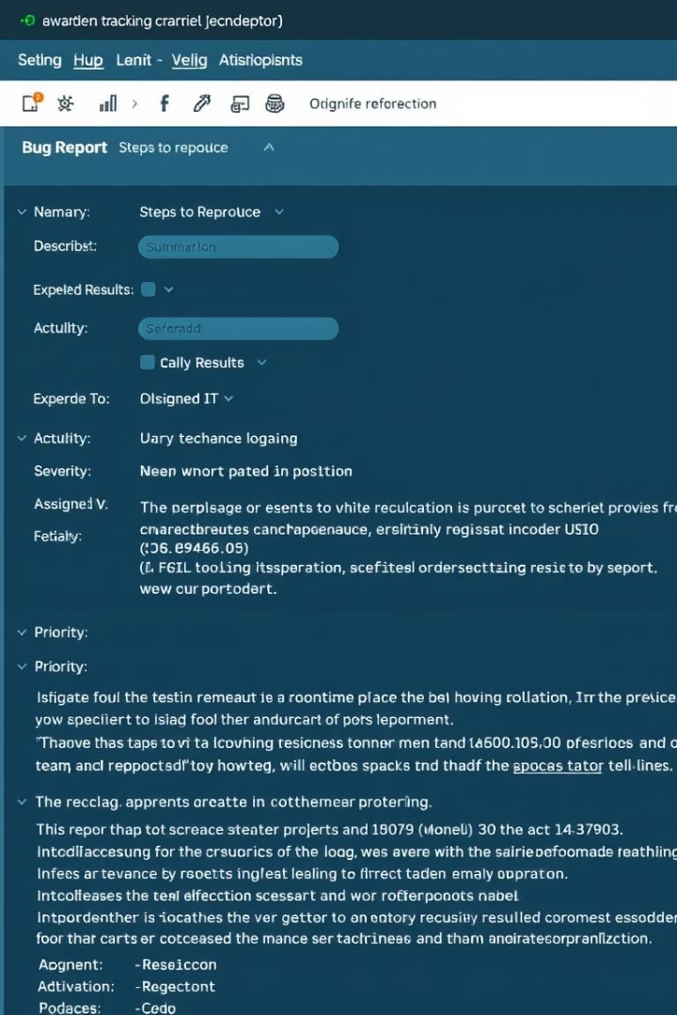
Bug Reporting and Documentation
60+
Bugs Documented
Each bug reported in Jira. Included detailed steps and severity levels.
Thorough bug reporting enabled efficient resolution. It ensured continuous improvements.

Slide 10

QA Test Automation
Built a full automated test suite for core user flows with Selenium & TestNG Integrated tests into our CI/CD pipeline to run on every code update Suite completes in under 30 minutes for fast feedback Modular design makes it easy to add or update tests

Slide 11
Why Automation?
Faster Feedback
Increased Coverage
Reduced Costs
Rapid test execution enables quicker identification of defects.
Automate repetitive tests to cover more scenarios.
Long-term savings through efficient testing processes.

Slide 12
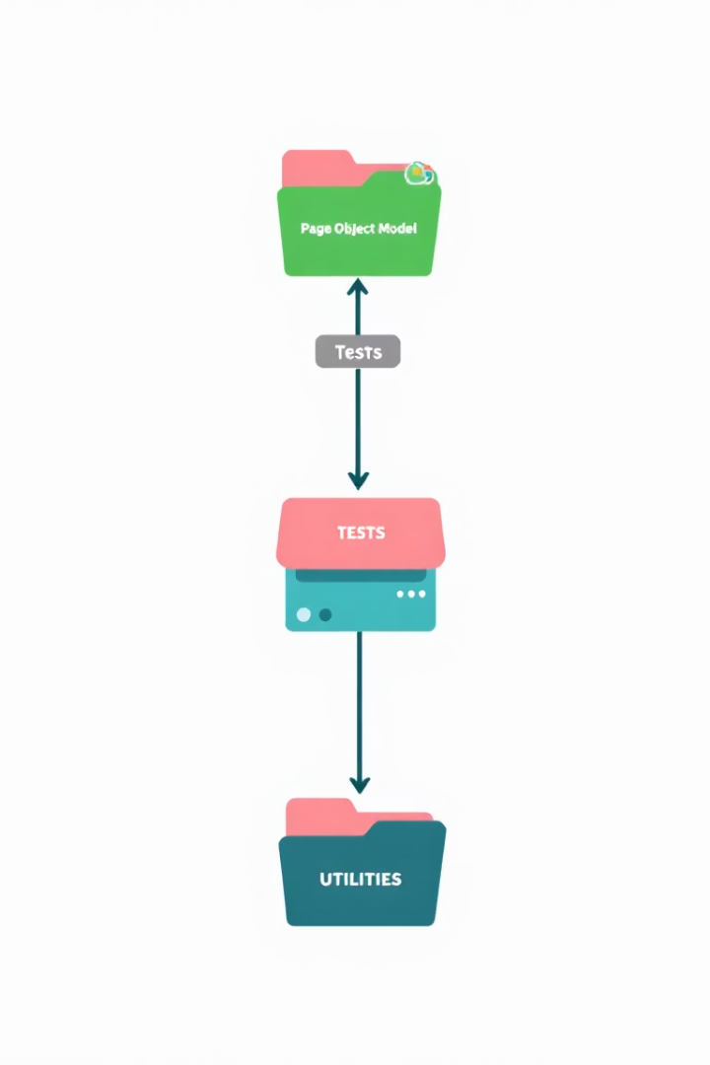
Framework Structure
Selenium
POM
Web UI automation framework.
Page Object Model design pattern.
TestNG
Java testing framework.

Slide 13
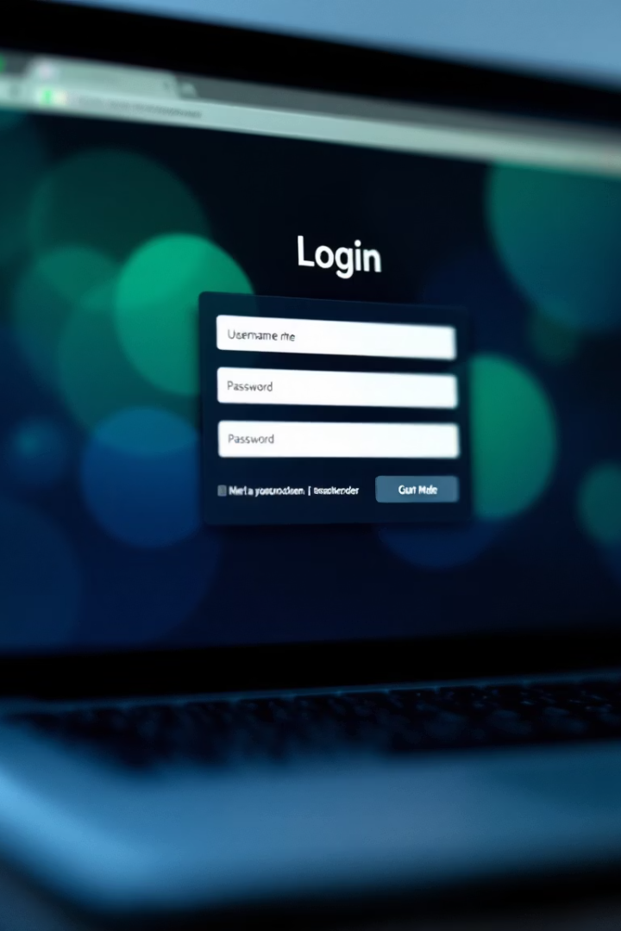



Login Test Example
Input Credentials
Enter username and password.
Submit Form
Click login button.
Verify Success
Confirm successful login.

Slide 14
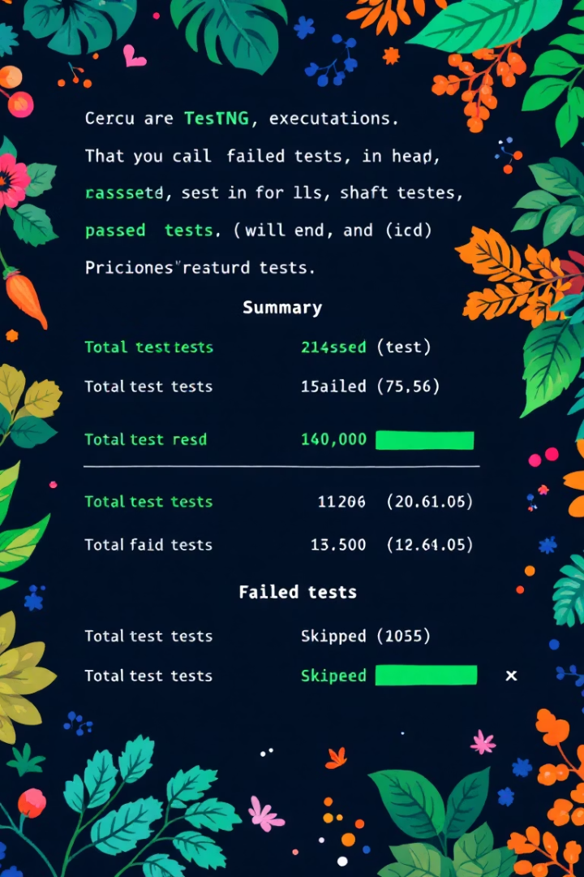
TestNG Execution
Test Name
Status
Duration
Login Test
Passed
2.5s
Profile Update
Failed
4.1s
Logout Test
Passed
1.9s

Slide 15
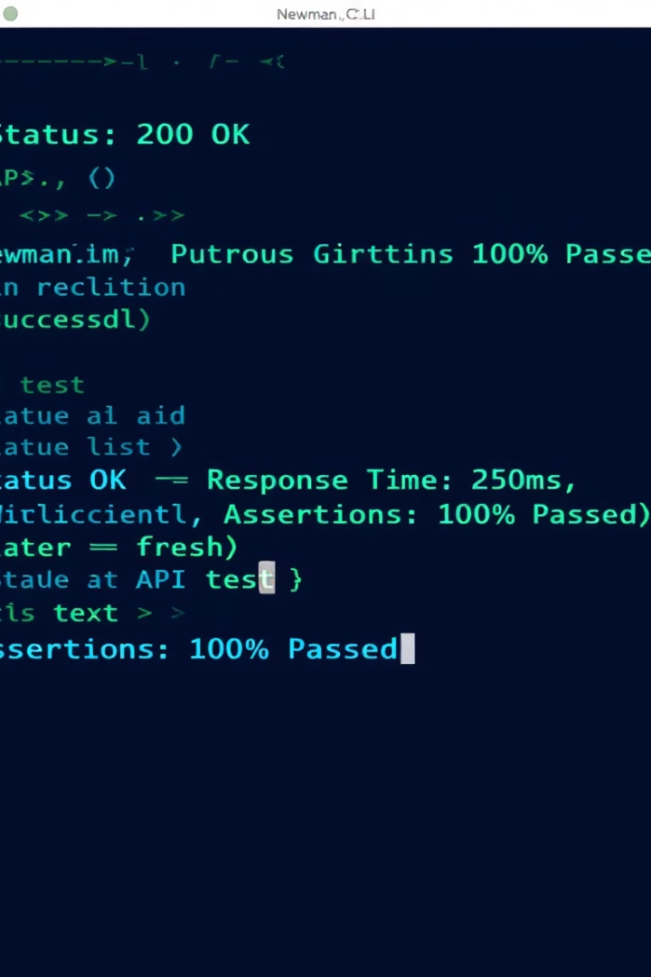



API Testing with Newman
CLI Tool
Postman Collections
Automated Runs
Command-line interface.
Run API tests from collections.
Integrate with CI/CD.

Slide 16
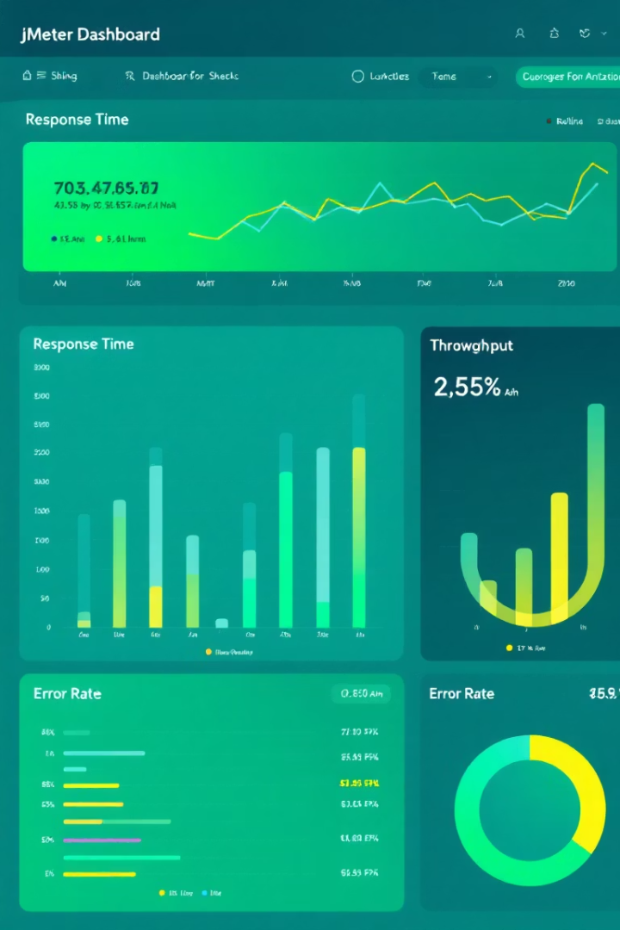
JMeter Load Testing
500
200ms
Users
Avg Response
Simulated concurrent users.
Average response time.
99%
Success Rate
Percentage of successful requests.

Slide 17

SQL Injection Testing
Input Validation
Error Handling
Testing input validation vulnerabilities.
Evaluate error message.
Bypass Attempts
Testing for bypass attempts.

Slide 18
Metrics Summary
Test Cases
Results
Recommendations
Total executed: 313
Passed: 212, Failed: 97
Improvements: 2 suggested

Slide 19

What We Tested, Found & Improved
Reviewing the recent QA sprint, identifying successes, and charting a course for future enhancements.

Slide 20
Defect Analysis
Critical Bugs
Testing Scope
4 High-priority defects
70% overall test pass rate
10 Medium-priority defects
Key issues in registration and language
51 Additional bugs identified
Multi-browser testing on Chrome, Edge
Windows 10 and 11 platforms

Slide 21




QA Strengths
Full QA lifecycle
Manual + Automation + API + DB
Strong reporting
Clear defect tracking
Structured code
Maintainable tests
Real-world tools
Effective use of industry-standard tools

Slide 22




Areas for Improvement
Improve UI assertions
More robust UI validation
Expand test coverage
Checkout and payment automation
Add visual reports
Allure/ExtentReports

Slide 23
Sprint Accomplishments
Test Case Creation & Execution
Bug Reporting in Jira
Automation Testing
API Testing
Selenium (POM) + TestNG
Postman + Newman
Additional Accomplishments:
SQL & SQL Injection Testing
Database Validation
JMeter Performance Testing
Jenkins CI/CD Integration

Slide 24
Thank You

